Slide 1
Analysis of factors that induce cysteine bonding state
Samad Jahandideh, Somayyeh Hoseini, Mina Jahandideh,
Afsaneh Hoseini, Ali Salehzadeh Yazdi
Computers in Biology and Medicine 39 (2009) 332 - 339
Presenter : Chih-Ying Lin
Date : Nov. 17, 2009

Slide 2
ABSTRACT
Regarding the fact that the protein structure is principally encoded in its sequence, investigating the bonding state of cysteine has gained a great deal of attention due to its significance in the formation of protein structure. Due to lack of evident influence of free cysteines on the protein structure, it may be expected that only half-cystines convey encoded information. The results obtained from the analysis of amino acid distribution in proximity of both states of cysteines explicitly indicated that perquisite information for inducing cysteine bonding state is present even in the flanking amino acid sequences of free cysteines.

Slide 3
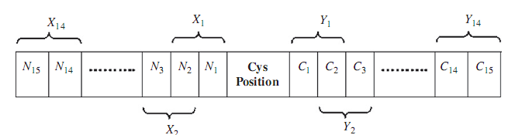
cysteine-centered windows

Slide 4
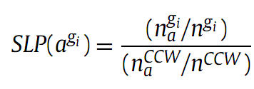
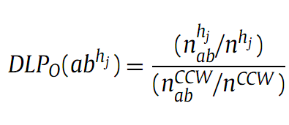

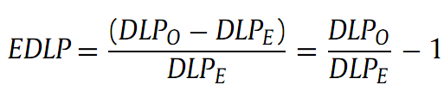
Statistical analysis

Slide 5
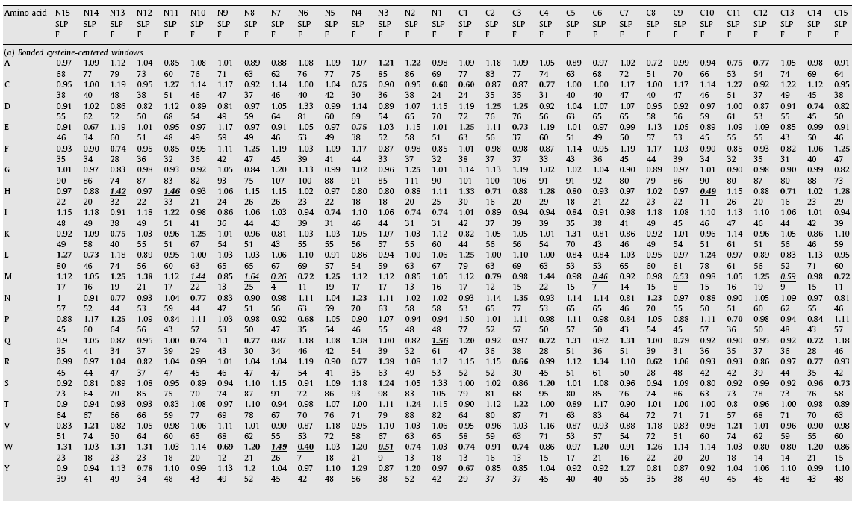
Results

Slide 6
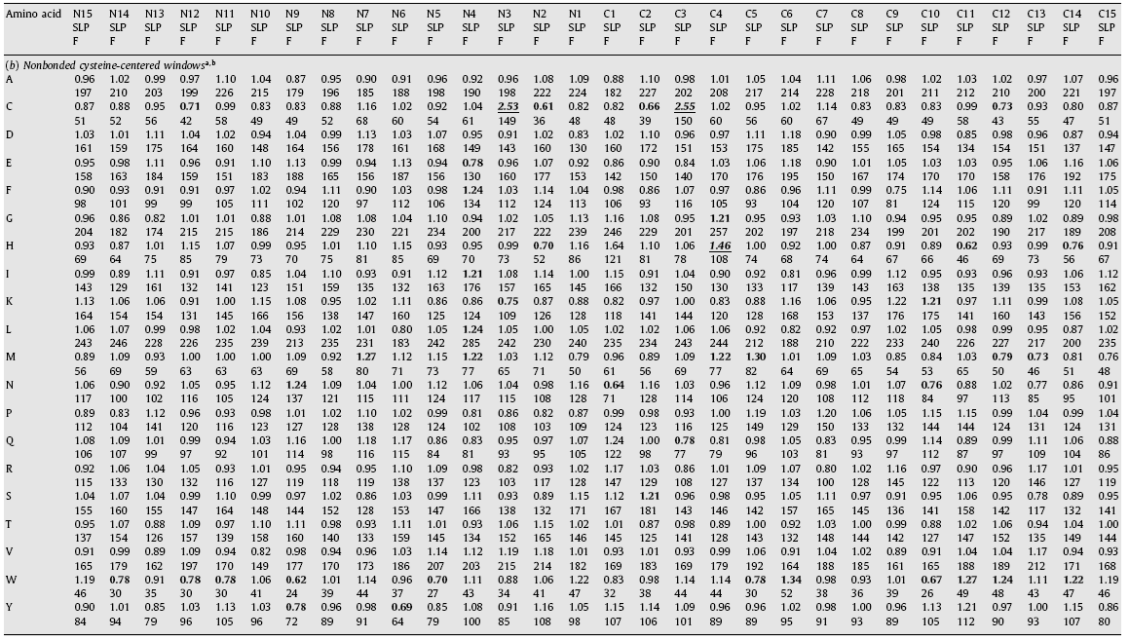
Results

Slide 7
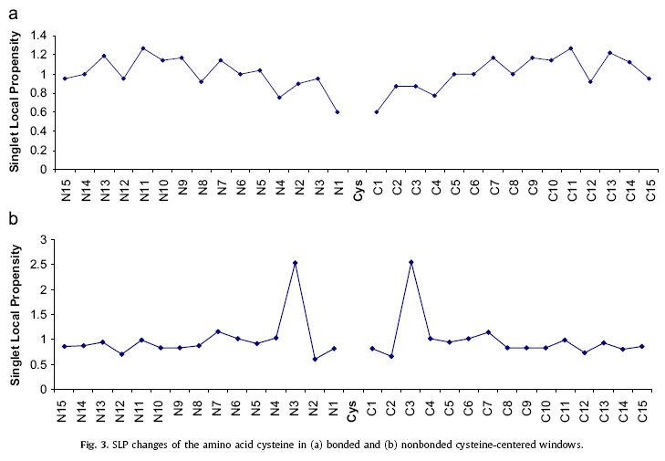
Results

Slide 8
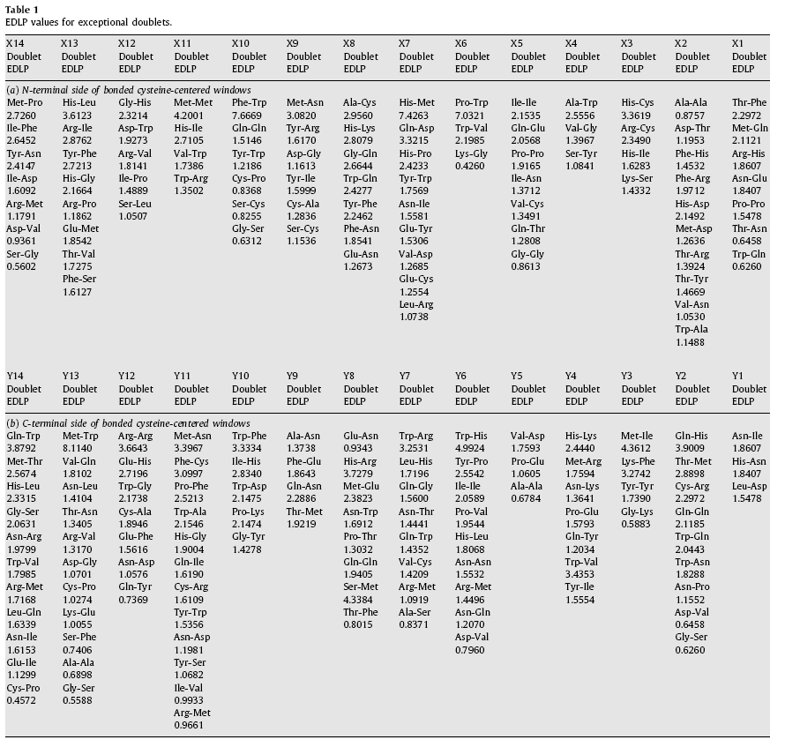
Results

Slide 9
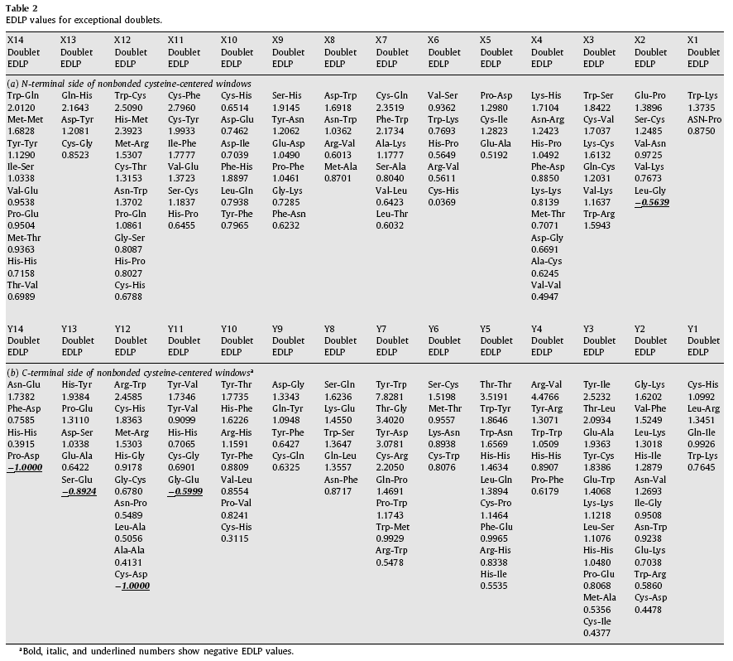
Results

